Slide 1
Azure storage
Az21

Slide 2
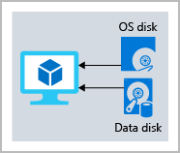

Slide 3
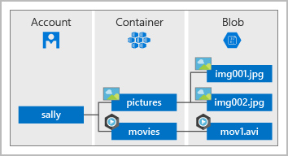

Slide 4
